Slide 1
SportsPlex Sprint 2
Presented By: Edward Marks, Peter Kowalski, Matt Degraeve, Anthony Saleh, Graydon Peck, Colin Neil

Slide 2
Sprint Goals
Use Case Creation
Wireframe Creation
User Registration Functionality
Website Layout/Flow creation

Slide 3
Risk Analysis
Risk | Likelihood | Impact | Priority | Mitigation Plan
Project Members not familiar with Github | 10 | 8 | 1 | We all studied up and tested our github accounts before we started our project
Misjudging of timeline and possible goals | 8 | 10 | 2 | Used Microsoft Project to create a timeline and made some goals stretch goals to free up time for tasks that take up longer than expected
Inadequate team member involvement | 3 | 5 | 3 | We discussed at the beginning of the sprint who would be taking on which tasks

Slide 4
Main Use Cases

Slide 5
Use Case UC-1: Generate Account Information
Summary:
This use case is designed for users who don’t already have an account. When a user first visits our website he/she will click on “Get Started”. At this point, a user will enter valid information in the steps for creating an account. Once all the required fields contain data, the user will click “Create”. As soon as the data is retrieved by the database, the user is signed into their new account.
Initiating Actor(s):
Customer
Actor’s Goal:
Register for SportPlex website and capability to review account information.
Preconditions:
A customer doesn’t have an account affiliated with them.
Administrator
Postconditions:
Customers gain access to User’s home page.
Added features are now available to view.

Slide 6
Flow of events for Main Success Scenario:
Customer Presses the “Registration Button” (Trigger Action)
System prompts the user for a username.
Customer Provides a valid username.
System prompts the user for a password.
Customer Provides a valid password.
System prompts the user for an optional email.
Customer supplies a valid email address.
System prompts the user for Date of Birth (DOB).
Customer Provides correct DOB.
System prompts the user with these required fields: Address, Zip, Phone Number, City, State, and SSN.
Customer Provides correct information.
System checks to see if all required fields are filled in. (* is a required field).
System checks for unique usernames and passwords to see if they already have been used.
Saves users credentials to the database if valid.
Customers press the “Submit” Button to confirm.
System notifies user via email that their account was successfully created.
Alternate flows:
System check discovers fixable deficiency: The user discovers a problem with connecting to Wi-Fi, but can fix it by powering the modem/ router down.
Button malfunction: The register button doesn’t operate as it’s supposed to, admins can fix it in a timely manner. (allowing users to continue registration).
Failed to register: The credentials entered failed. The user must make sure all the required fields are filled out. ( * indicates a required field).

Slide 7
Use Case UC – 2: Login into Account
Summary:
This use case is designed for users who already made an account. In this case, A user will click on “Sign in” to access their account. When users access their account, they will gain different permissions than someone who hasn’t made an account. The user will gain access to buying items and setting rink date/times and possibly more.
Initiating Actors(s):
Customer
Employee
Administrator
Actor’s Goals:
Login to SportPlex and begin using the website.
Preconditions:
All users are already registered for the website.
All users are not already signed into the website.
Postconditions:
All users are sent to User’s home page.

Slide 8
Flow of Events for Main Success Scenario:
Users navigate to the SportPlex website.
Customers click on “Customer Login” Button (Trigger Action).
Employee’s click on “Employee Login” Button (Trigger Action).
System prompts the Customer for login credentials.
Customer enters the login credentials and presses “Login”.
System prompts the Employee for login credentials.
Employee enters the login credentials and pressed “Login”.
Alternate Flows:
System hesitates to log in user: User trying to access their account with entering the wrong credentials. Entering the correct credentials will fix this problem.

Slide 9
Use Case UC – 4: User’s Home Page
Summary:
This use case is designed for giving users ability to see weekly events and important information. Each user will be able to view the home page without signing into their account. With that in mind, the functionality of what each user can do will be very limited. Users are giving the ability to a little preview of our site before creating an account.
Initialing Actor(s):
Customer
Employee
Administrator
Actor Goals:
Giving users ability to view important/needed information.
Preconditions:
Users must be logged in.
Postconditions:
Reservations made by each user will be listed.
Map will be viewable
Calendar with available rink times/dates will be viewable.

Slide 10
Wireframe to life

Slide 11
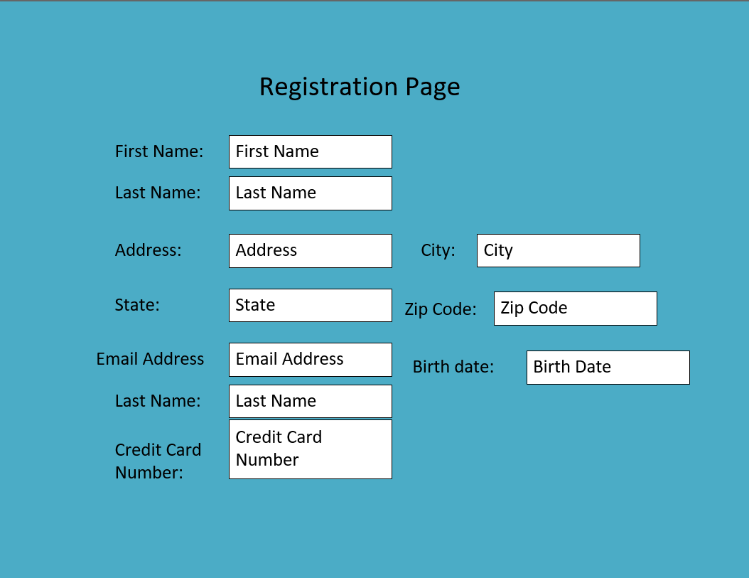
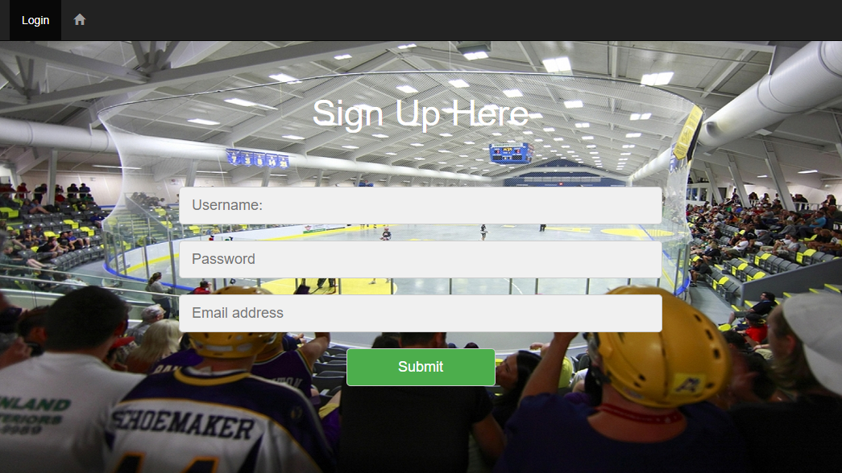
Registration Page

Slide 12
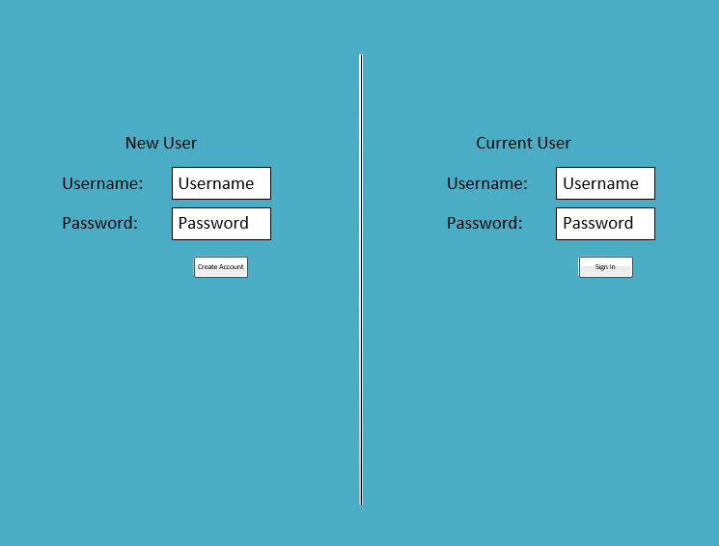
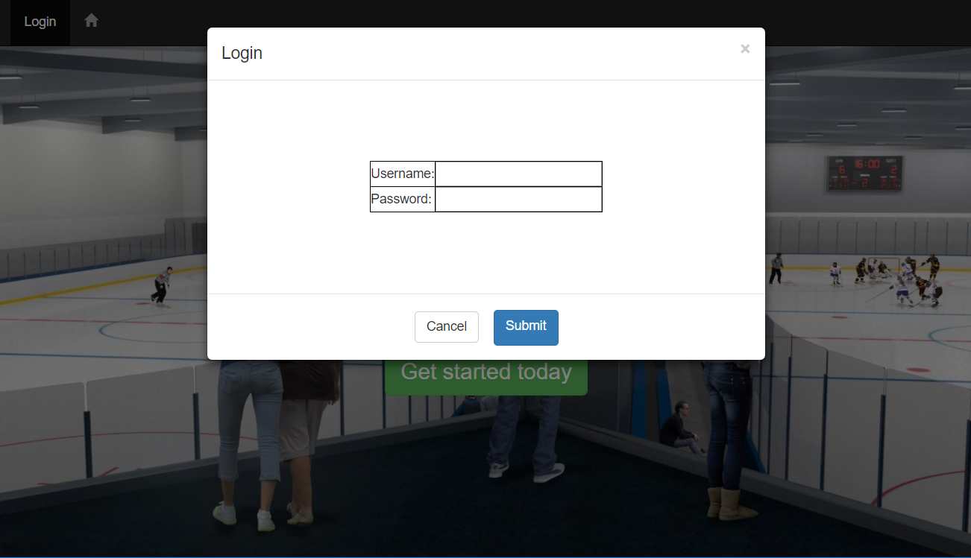
Sign In

Slide 13
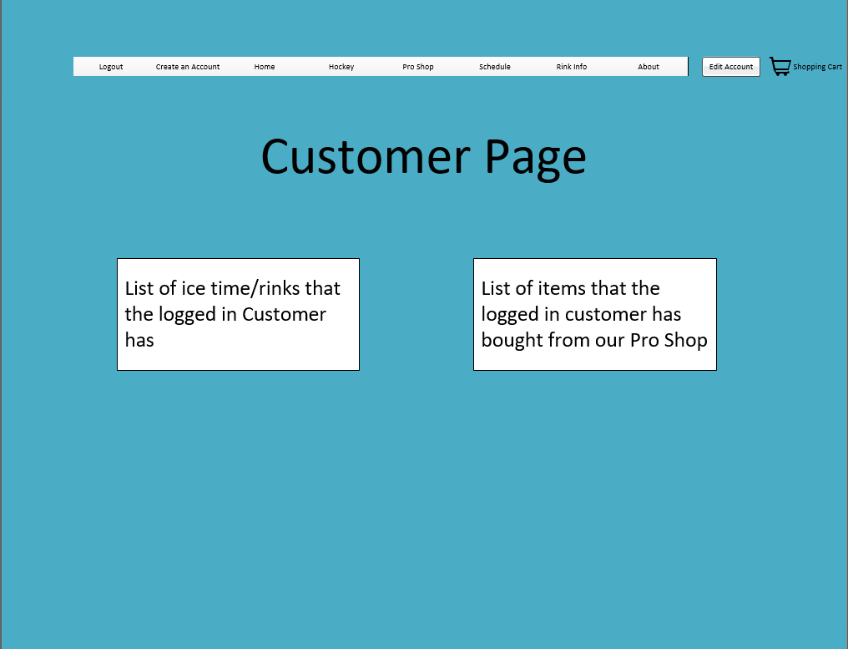
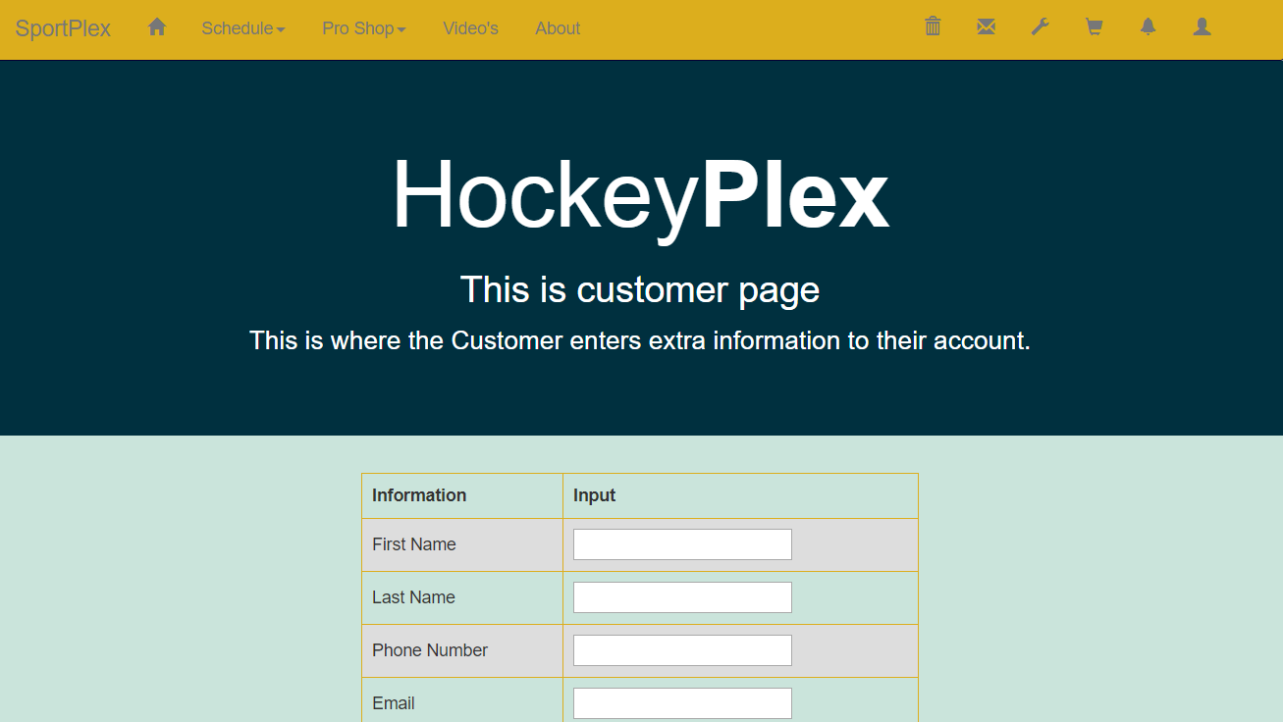
Customer Page

Slide 14
Next Sprint Goals
Have the user page initial design done and created
Have the Database Architecture setup and configured correctly

Slide 15
END

